Slide 1
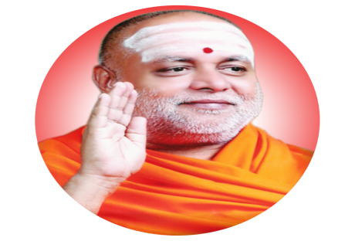
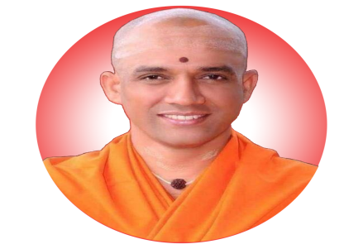
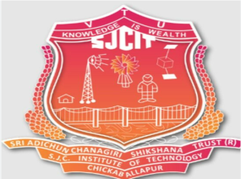
|| Jai Sri Gurudev ||
SJC INSTITUTE OF TECHNOLOGY
(Affiliated to VTU ,Belgaum)
DEPARTMENT OF ARTIFICAL INTELLIGENCE AND DATA SCIENCE
5th Sem Mini-Project First Review 2024
IMAGE –TO-TEXT CONVERSION
Project Team Members
Name USN
M CHARAN 1SJ22AD024
M AKASH 1SJ22AD021
A CHETAN 1SJ22AD005
Y REVANT 1SJ22AD063
Project Guide
Naveen V G
Assistant Professor

Slide 2
Image-to-Text Conversion System

Slide 3
Table of Contents
Problem Statement
Abstract
Introduction
Existing System
Proposed System
Software and Hardware Requirements
System Architecture
Expected Output
References

Slide 4
Problem Statement
Millions of visually impaired people worldwide face challenges in accessing visual information. Whether it's educational materials, daily news, or social media content, the lack of accessibility tools hinders their ability to fully participate in various aspects of life.

Slide 5
Abstract
Converting image information into text is a critical task in computer vision and natural language processing with applications in accessibility, content generation, and data analysis. This project focuses on developing an automated pipeline that can accurately interpret visual data, extract relevant details, and generate descriptive text output. By combining deep learning techniques in object detection, optical character recognition (OCR), and image captioning models, the system identifies and interprets visual elements within images, such as objects, text, and contextual scenes. The project aims to achieve high accuracy in translating complex visual scenes into structured text, allowing applications in fields ranging from digital accessibility for visually impaired individuals to automated metadata creation for media content

Slide 6
Introduction
This project focuses on creating a system to extract text from images and translate it into a desired language using Optical Character Recognition (OCR) and neural networks integrated with the Google Translator API. Designed for smartphone-captured images, the system addresses challenges like varied text styles, noisy backgrounds, and complex orientations.

Slide 7
Existing System
Objective: Build an OCR-based system to extract text from images such as printed documents, receipts, or handwritten notes.
Key Features:
Image Preprocessing: Convert to grayscale, apply thresholding, and enhance text visibility.
Text Detection and Recognition: Use OCR to identify and extract text regions.
Output: Display or save recognized text.
Python Libraries:
pytesseract: Tesseract wrapper.
opencv-python: Image processing.
Pillow: Basic image handling.

Slide 8
Proposed System
The proposed system is designed to convert images into text using a combination of cloud-based models and APIs.
Input from Python Code: The system is initiated via a Python script, which sends an API request containing the image to be processed.
API Request to Clarifai: The image data is sent to Clarifai's model hosted in a container on cloud storage. Clarifai processes the request using its pre-trained models for image classification and feature extraction.
Backend Processing: Clarifai's backend receives the API request and runs the model (e.g., CNN or other image classification models) to analyze the image. Integration with OpenAI GPT-4 Vision: The processed output is sent to the main backend, where OpenAI GPT-4 Vision is deployed for further text generation and contextual understanding.
Output Delivery: The final result, in text form, is sent back to the Python script for further use or display. This system combines the power of Clarifai's image recognition with OpenAI GPT-4's natural language processing capabilities to provide a seamless image-to-text conversion workflow.

Slide 9
Software and Hardware Requirements
Hardware:
Microcontrollers: Camera Lenovo Essential FHD Webcam Black
Systems: Windows, Linux
Software:
Programming Languages:
Backend: Python
Frontend: HTML, CSS, JavaScript
Encryption Algorithms:
Model Names: Model By Qresearch,
llama-3-vision-alpha-hf
Post Deployment Analytics: Prometheus Regulatory Compliance: WCAG

Slide 10
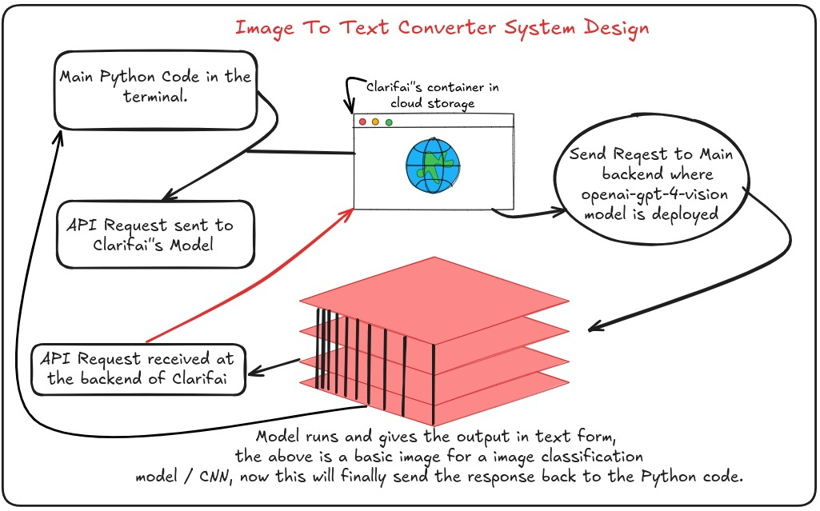
System Design / Architecture

Slide 11
Expected Output
Accurate Text Extraction: The system should effectively recognize and extract text from images with varying fonts, sizes, and orientations.
Support for Multiple Formats: The input image can be in formats like PNG, JPEG, or BMP, and the tool should process them seamlessly.
Readable Text Output: The extracted text should be clean and readable, with minimal errors in character recognition.
Handling of Noisy Images: The system should handle challenges like noise, blurred text, or low-light conditions, providing reasonable accuracy.
Language Support: If applicable, the system should identify text in multiple languages or indicate its limitations.
Optional Enhancements: Features like recognizing handwritten text, text layout preservation, or extracting text from complex backgrounds can be added for advanced functionality

Slide 12
References:
Research Papers and Articles: A Survey on OCR Applications in Image Processing- https://ieeexplore.ieee.org/Xplore/home.jsp
Pytesseract: Python wrapper for Tesseract OCR- https://pypi.org/project/pytesseract/
Google Vision API: Cloud-based OCR tool for extracting text from images

